Slide 1
Tackling Social Dumping
Actions against the “Caporalato” system in the agriculture field
17 June 2020
European Migration Network- IT National Contact Point

Slide 2
Agenda
The Technical Commission
1
6
Introduction
7
2
The Action Plan
The primary sector in Italy
8
3
The Covid-19 pandemic response
The main features of gangmasters
How it works
4
The legislative framework
5

Slide 3
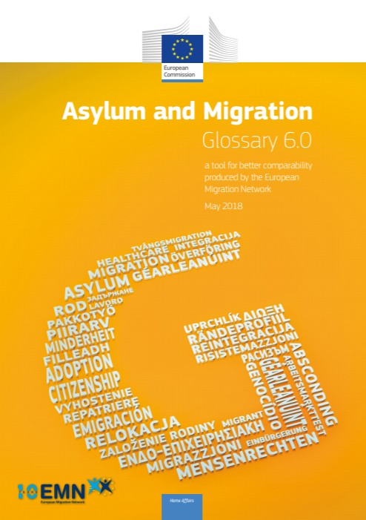
Introduction
Social dumping takes different forms in different sectors, but it is clear that it is a strategy based on unfair market competition and aimed at maximize profits. It is used and accepted by States, by companies and sometimes by workers.
When it comes to undeclared work it becomes also criminal
The EMN Glossary on migration defines Social dumping as “the practice whereby workers are given pay and /or working conditions which are sub-standard compared to those specified by law or collective agreements”.
In Italy, the illegal form of workers recruitment and exploitation is called “Caporalato”, translated in English as gangmasters system.
Gangmasters are criminal recruiters who control and exploit workers. This criminal system involves various sectors (transport, construction, logistics and care services), but it is particularly strong in the agricultural field, characterised by a prevalence of short-term and seasonal jobs.

Slide 4
Some numbers about the primary sector in Italy
Trentino Alto Adige
Friuli Venezia Giulia
Max
Aosta Valley
Lombardy
Veneto
1,125,000 agricultural workers
Piedmont
[0 to 100[
[100 to 200[
Emilia Romagna
[200 to 300[
Liguria
[300 to 400[
400+
Tuscany
Marche
405,000 foreign workers (both regular and irregular)
Umbria
Min
Lazio
Abruzzo
Molise
Puglia
39% is the estimated rate of irregularity
Campania
Sardinia
Basilicata
Calabria
132,000 workers are in a state of serious social vulnerability
Sicily

Slide 5
The main features of gangmasters
1
The mediation between supply and demand in a given geographical area, and in a specific sector.
2
It focuses on the weaker targets: vulnerable people, in particular migrants.
3
The monopoly of the transport system, which forces workers to pay to get to and from workplaces.

Slide 6
How it works
The gangmaster manages illegally all labour requirements, duties, salaries and transportation of workers to workplaces.
The work performed is often irregular with consequent tax and contribution evasion and in violation of labour standards and requirements.
Workers are employed for 8-12 hours per day with no protection or rights. They pay for transportation and all basic needs to gangmasters.
The result is the systematic violation of the most basic human, social and economic rights. It is not uncommon the use of physical violence.
The gangmaster is part of a structured criminal organisation with a strict division of roles and responsibilities.
In 2019, the military police conducted 263 investigations to fight the gangmaster system.

Slide 7
Evolution of the legislative framework
1949
Introduction of fines for illegal intermediation.
1998
The Italian Immigration Law punishes with imprisonment from 6 months to 3 years and a fine of 5,000 euros for each worker, the employer who "employs" foreigners without residence permits.
2011
The offence of “Illegal intermediation and labour exploitation” (Art. 603 bis Penal Code) was introduced into the Penal Code (Leg. Decree no. 138/2011).
2012
The Implementation of the Employers Sanctions Directive 2009/52/EC provided specific sanctions and measures against employers of irregular migrants.
2016
Law 119/2016 was approved, specifically aimed at fighting undeclared work and exploitation in agriculture. The law further introduced new forms of support for seasonal workers in agriculture.
2018
Set up of the Technical Commission for the definition of a new strategy for countering gangmasters and labour exploitation in agriculture.
2020
Decree-Law n. 34 adopted in response to the Covid-19 pandemic to ensure adequate health protection and to encourage the emergence of irregular employment.

Slide 8
Technical Commission against exploitation and the gamgmaster (s.c. Tavolo Caporalato)
In 2018, the Technical Commission for the definition of a new strategy for countering gangmasters and labour exploitation in agriculture was set up (Leg. Decree 119/2018).
Chair
Ministry of Labour and Social Policies
Ministry of the Interior
Ministry of Justice
Ministry of Agriculture
Ministry of Infrastructure & Transport
National Labour Inspectorate
INPS
Military& Tax Police
ANCI
ANPAL

Slide 9
The Action Plan
On February 20, 2020, the Technical Commission adopted an Action Plan against “Caporalato”. The Plan (2020-2022) develops the national strategy to combat “gangmasters” and labour exploitation in agriculture around four priority axes:
ACTION PLAN
CHALLENGES
1
Surveillance and repression of the gangmaster phenomenon
1
2
Price adjustment of agricultural products
2
Prevention
Oversight
3
Intermediation between demand and supply
AXES
Working Groups
4
Transportation and accommodation
Reintegration
Protection
4
3
5
Development of quality in the labour network
6
Enhancement of the Employment Centers' role

Slide 10
Covid-19 pandemic response
On May 19, 2020, the Italian Government adopted Decree-Law n. 34 to ensure adequate health protection in response of the Covid-19 pandemic and to encourage the emergence of irregular employment.
SECTORS
MAIN PROVISIONS
Agriculture, livestock and animal husbandry, fisheries and aquaculture and related activities
Employers (nationals, EU citizens or EU long-term residence holders) can apply to sign a job contract with irregular foreign citizens or declare an irregular employment relationship.
Assistance to people or family members suffering from pathologies or handicaps
Foreign citizens, with a residence permit expired as of October 31, 2019, who can demonstrated have worked in the sectors foreseen, may apply for a temporary residence permit of 6 months, valid only in Italy, in order to find a job.
Domestic work to support family needs
Applications may be submitted from 1 June to 15 July 2020.
The Decree will contribute to tackle the gangmasters system. It will assist the agricultural sector affected by seasonal labour shortage due to travel restriction, and will reduce the stock of irregular migrants in Italy.

Slide 11
Thank you for your attention!

Slide 12
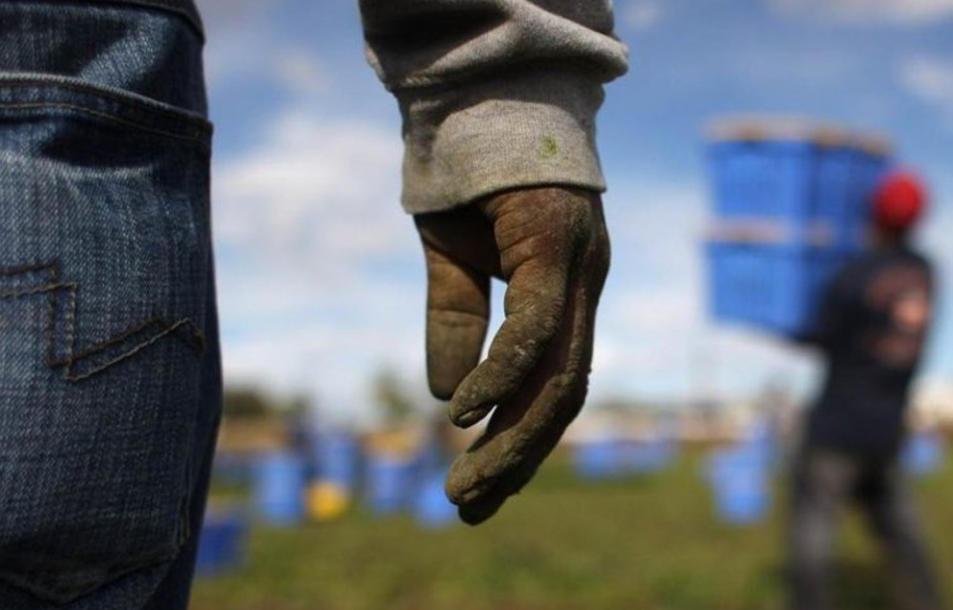
Relevant data
on caporalato
FOURTH REPORT ON AGRO-MAFIAS AND GANGMASTERS 2018
Placido Rizzotto Flai Cgil Observatory

Slide 13
Relevant data on ‘’Caporalato’’ (1/6)
Economic crime and illegal economy
The main activities of agromafia
Economy not observed in Italy: € 208 billion euro
Trafficking in human being for the porpouse of serious exploitation
Irregular employment is worth 77 billion euro (37,3%)
Illegal labour intermediation
Irregular employment
(37,3%)
Import/export of agri-food products
Fraud against EU
Economy not observed
Wholesale and retail supply exposure
63%
Recycling and extorsion
Infiltration in the management of fruit and vegetable markets
15,5%
Incidence of the agricultural sector’s irregular employment on the added value of the agricultural sector
Infiltration in the logistics and business service sector
€ 4,8 billions
Irregular employment and «caporalato» bus i ness i n agricolture
Poaching
€ 1,8 billions
Only for tax evasion
Infiltration in renewable energy sector linked to agricultural activities

Slide 14
Relevant data on ‘’Caporalato’’ (2/6)
€
1billion euro
the value of seized counterfeit food products from 2012 to 2016
Slaughtering
Fruit&Vegetable
Milk products
33 million Kg
Of food products and 60 million litres of liquid products (in particular oil, milk and wine)
The main product sectors at risk
Fishing
Wine
Bakery
The Financial Police has estimated has estimated the loss of tax due to counterfeiting in 5,7 billion euros and about 100,000 regular jobs lost.
ltalian sounding
60 billion euros is the value of agri-food products sold abroad
Plants products for industrial processing

Slide 15
Relevant data on ‘’Caporalato’’ (3/6)
39%
Irregularity rate of labour relations in agriculture
400.000/430.000
Agricultural workers exposed to the risk of irregular and under caporalato recruitment
Irregular employment and caporalato
More than 300.000 agricultural workers
work for less than 50 days a year (almost 30% of the total)
Presumably there is a lot of irregular work in this basin
More tha 132.000
Are in a state of serious social vulnerability and severe occupational distress
7265
Companies audited by the Labour Inspectorate
360 company suspension procedures
87% of them revoked after regularisation
Inspections & control activities (2017)
More than 50%
Companies audited presenting irregularities
284 people referred to judicial authorities
of which 71 under arrest for the crime of working and caporalato exploitation
12 irregular workers identified
The number of marks made by the Labour Inspectorate rose from 9 (in 2016) to 94 (in 2017) with 387 victims of caporalato exploitation recorded
3549 undocumented workers, almost 67%

Slide 16
Relevant data on ‘’Caporalato’’ (4/6)
Territorial distribution of arrests and denouncements for “Caporalato” crime

Slide 17
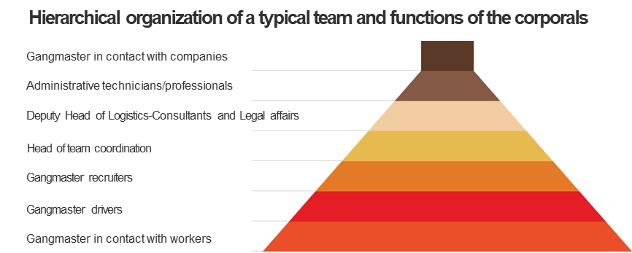
Relevant data on ‘’Caporalato’’ (5/6)
Conditions of workers subjected to serious exploitation in agriculture
In 220 agricultural districts, on average 500/700 agricultural workers are irregularly recruited and employed in indecent conditions with manifest peaks of para-slavery subjugation.
According to estimates, in districts there are about 34 gangmasters, about 102 per province and about 15.000 throughout the national territory.
Each province is characterized by the presence of 3/4 agricultural sub-areas, where on average there are gangmasters with different social profiles: on average 21 team leaders, 10 managerial leaders, 2 colluded with the criminal organizations and 1 organic team with a mafia gang.
No protection and rights guaranteed by contract and law
Avarage pay between 20-30 € per day
Avarage working hours from 8 to 12 hours per day
Piecework for a fee of 3/4 € for a 75Kg
Approximately 50% lower salary than the national collective bargaining agreements
Paying the transport to the gangmaster depending on the distance, on avarage 5 euros
Women receive a salary 20% lower than theit collegues
Paying for basic necessities (on avarage 1,5€ l, 3€ for sandwich, etc)
In serious case of exploitation, some migrants workers received a salary of 1€ per hour

Slide 18
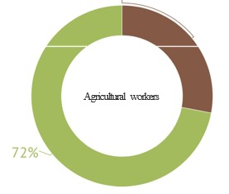
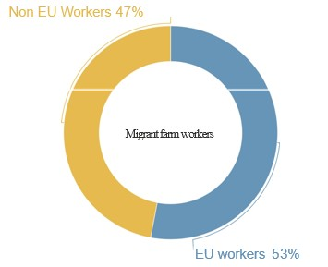
Relevant data on ‘’Caporalato’’ (6/6)
Migrant workers 28%
Agriculture and migrant work
Out of about one million agricultural workers, migrants remain a fundamental resource:
2017: 286.940 migrants workers of which:
151,706 from the EU (53%)
and 135,234 from non-EU countries (47%).
To these data must be added the estimates on undeclared work:
405,000 Foreign workers in agriculture (between regular and irregular)
of which 16.5% have an informal employment relationship (67,000 units) and 38.7% a non-union salary (157,000 units

Slide 19
Resources
https://www.europarl.europa.eu/RegData/etudes/BRIE/2017/599353/EPRS_BRI(2017)599353_EN.pdf
https://www.eurofound.europa.eu/observatories/eurwork/industrial-relations-dictionary/social-dumping#:~:text=Social%20dumping%20is%20a%20hotly,at%20the%20exploitation%20of%20workers.&text=Andr%C3%A9%20Sapir%20(2015)%20uses%20the,countries%20with%20lower%20social%20conditions’.
https://www.europarl.europa.eu/RegData/etudes/BRIE/2017/599353/EPRS_BRI(2017)599353_EN.pdf
https://www.lavoro.gov.it/priorita/Documents/Piano-Triennale-contrasto-a-sfruttamento-lavorativo-in-agricoltura-e-al-caporalato-2020-2022.pdf
https://www.flai.it/osservatoriopr/il-rapporto/

Slide 20
Resources
https://www.crea.gov.it/-/immigrati-in-agricoltura-3-studi-crea-politiche-e-bioeconomia?inheritRedirect=true&redirect=%2Fweb%2Fagricoltura-e-ambiente%2Fsearch%3Fq%3Dcaporalato
file:///C:/Users/stefa/Downloads/4RAPP_scheda_sintesi_ENG.pdf
https://temi.camera.it/leg17/post/OCD25-272.html?tema=temi/nuovi_reati_d
http://www.integrazionemigranti.gov.it/Attualita/Notizie/Documents/DECRETO%20LEGISLATIVO%2016%20luglio%202012.pdf

Slide 21
Questions & answers from the webinar
1. Do you have data on how many irregular migrants have filed a complaint to the competent authorities and been able to successfully get a residence permit as a result (not apply but actually receive the permit)?
In line with Article 18 of the Consolidated Text on Immigration (Law n. 286/1998), a foreigner who is in a situation of violence or serious exploitation can obtain a residence permit “for reasons of social protection". Such a permit is issued by the Police Authority (i.e. the Questore) if there is a concrete danger for the safety of the foreigner, enabling him/her to participate in a program of assistance and social integration.
Moreover, according to article 22, paragraph 12-quater, in case of particular labour exploitation, a residence permit is issued by the Police Authority, upon proposal or with the favourable opinion of the Public Prosecutor, to the foreigner who has filed a complaint and cooperates in the criminal proceedings against the employer.
In terms of data, the updated number of irregular migrants who have filed a complaint to the competent authorities and been able to successfully get a residence permit is not available.
2. In the case that the irregular migrant has not received their wages by their employer are they able to get their unpaid wages once they file a complaint?
Yes, the irregular migrant who works without receiving a salary may take a legal action to request the recognition of the work relationship and the actual payment of the amounts due.

