Slide 1
E-applications in Sweden
Marie Bengtsson, EMN Sweden
17 June 2020

Slide 2
E-applications
For many different types of applications for legal migration
Labour (both for employers and employees)
Students
Family reunification
Notes:
For first time applications
Labour 85%
Studenter 97%
Family 48%
The goal is that more applications should be digital

Slide 3
E-applications
But also for:
Citizenship
Visa - only for four embassies so far:
Dar es Salaam, Tanzania
Seoul, South Korea
Teheran, Iran
Tokyo, Japan
Notes:
For first time applications
Labour 85%
Studenter 97%
Family 48%
The goal is that more applications should be digital

Slide 4
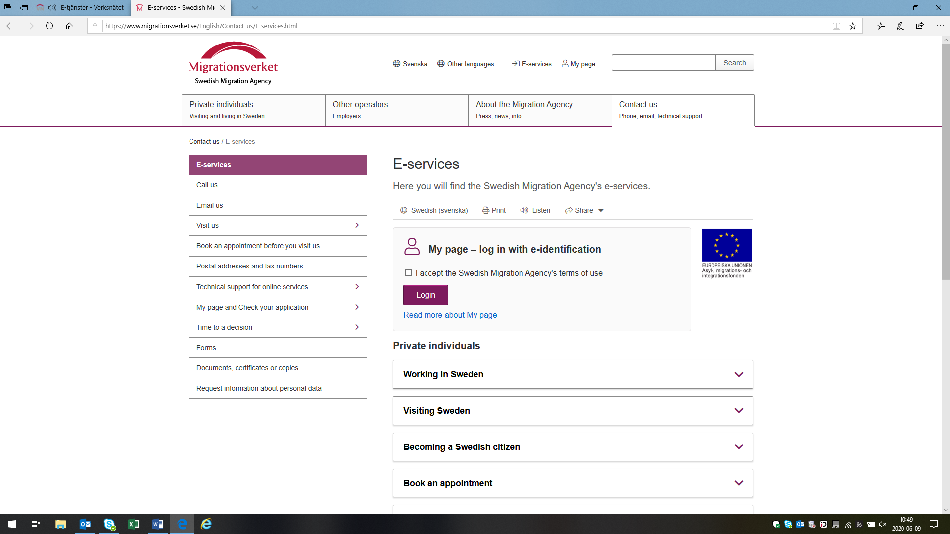
Notes:
Everything at the same place at the external webpage of the Swedish Migration Agency

Slide 5
Notes:
Step-by-step

Slide 6
Information to the applicant
”My Page”
The applicant can follow his/her case during the handling

Slide 7
Advantages
More complete applications
Integrated submission of documents
Digital payment
Digital processing
Better service to applicants
Lower processing costs

Slide 8
Thank you for your attention!
EMN@migrationsverket.se

Slide 9
Questions & answers from the webinar
Is it possible also for asylum seekers to apply online for international protection in Sweden?
No.
For more information about the e-applications in Sweden, please visit the webpage of the Swedish Migration Agency www.migrationsverket.se or contact the Migration Agency directly.

