Slide 1
Labour Market Integration in Europe
Dr Ave Lauren
EMN Estonia

Slide 2
Overview
Background
Challenges
General trends
Good practices

Slide 3
Background
Main reasons migrants come to Europe:
family reasons (44%);
work (33%, out of those only 24% come with a job offer);
education (8%), asylum (6%) and other reasons (5%).

Slide 4
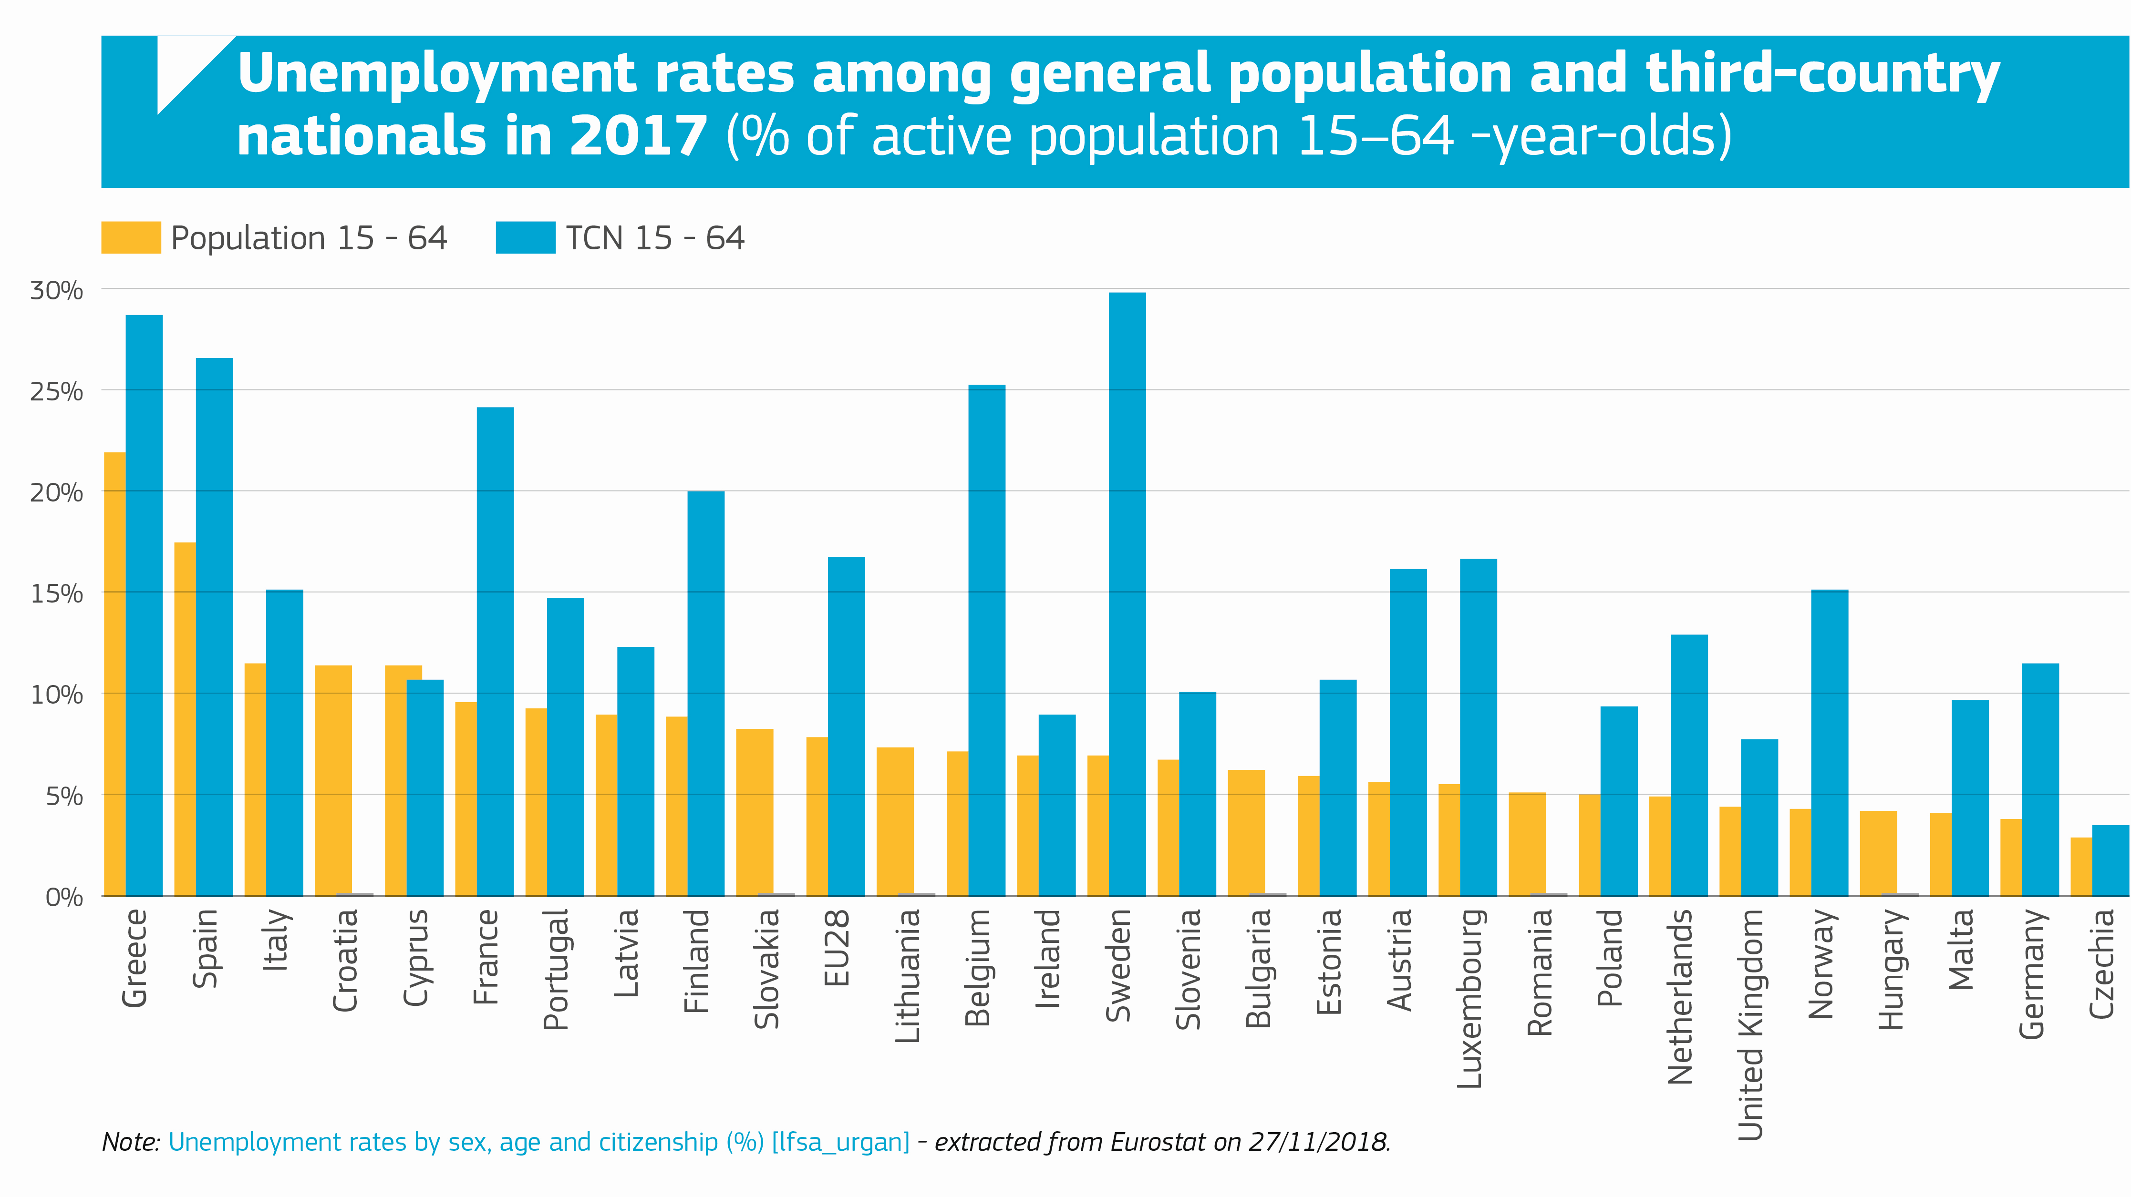

Slide 5
Challenges
Why do migrant workers find it hard to gain and keep employment in the EU?
Language
Accreditation of qualifications
Assessment of skills
Discrimination within recruitment processes and in the society as a whole
Limited awareness of support services
Large influx of migrants (or workers in general) with a similar skill set at the same time may limit opportunities

Slide 6
Language
Fundamental to integration in general, but has a major impact on employment opportunities, career mobility and professional networking.
Recognition of skills and qualifications
Inability to get your credentials recognised could lead to unemployment, underemployment or social dumping.
Major challenge in Estonia and Scandinavian countries
Major issue in Austria, France, Germany, Italy and Spain

Slide 7
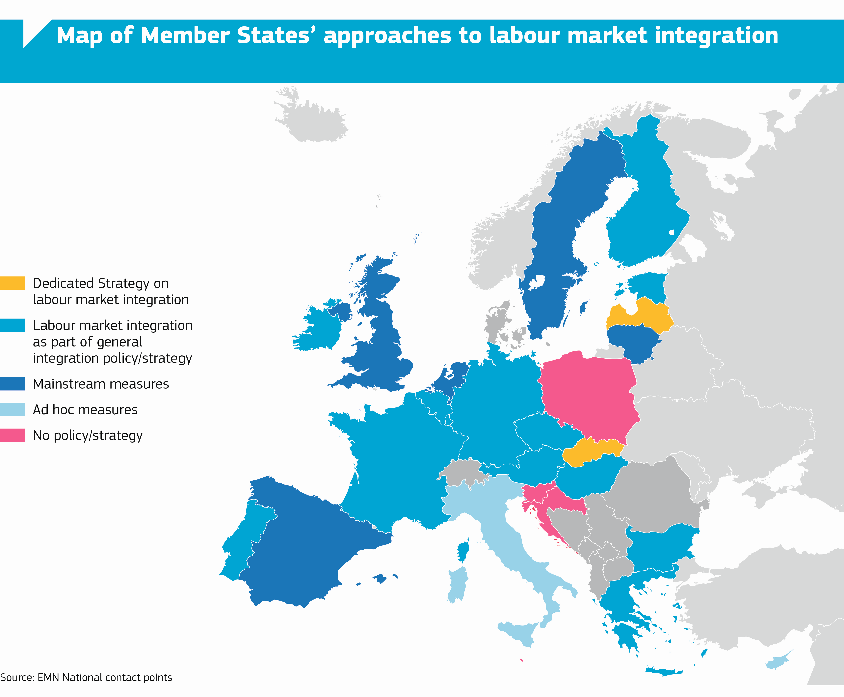
What is being done in Europe?
EU labour market integration policies tend to have a two-fold objective: attract and control
Public sector integration measures in Europe focus primarily on the phase prior to accessing employment.
Private sector focuses on workplace onboarding and intercultural relations.

Slide 8
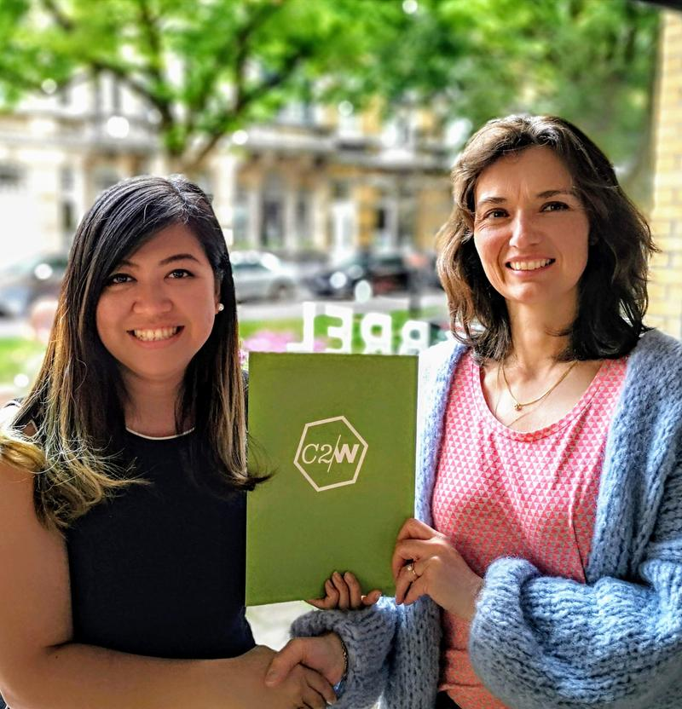
Professional language training
Measures to support language training in a professional field, sometimes combined with professional networking, for instance:
Professional Swedish for Immigrants/Yrkessvenska (Sweden)
Connect2Work/C2W (Belgium)
La Fabrique NOMADE (France)

Slide 9
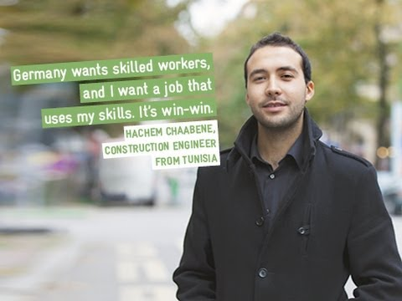
Skill recognition and in-house training to bridge gaps
Measures to provide evidence of skills, training to bridge potential gaps and industrial placements, for instance:
MySkills (Germany)
IQNetwork (Germany)
Private sector measures to bridge the gaps and build talent in-house:
ENGIE (Belgium) offering training courses for migrant women

Slide 10
Thank you! ave.lauren@tlu.ee

